Slide 1
Conference Paper Submission
S SHREE LAKSHMI (1BM19CS136)
SAKSHI ROY (1BM19CS140)
SHARAN S PAI (1BM19CS146)
SHASHANK SHARMA (1BM19CS147)

Slide 2
Objective
Taking part in a conference provides an opportunity to meet like minded people and go through the work of people who share a common discipline. Through our website students and faculties can take part in various conferences and widen their horizon in their respective field.
Our website allows students/faculties from all colleges to get information about the recent conference’s organized by B.M.S College of engineering, submit their respective conference papers as well as receive feedback regarding their paper from the reviewer.
It allows for an online and seamless experience for Conference paper submissions as it is of immense value if one needs faster feedback regarding the latest scientific innovations.

Slide 3
Requirements
Hardware Requirements
A PC with the following or greater specifications:
Intel Core i3 or higher ,
4 GB RAM
500 GB Hard Drive
A stable internet connection (2Mbps +)
Software Requirements
Operating system : Windows
Front end technologies are : HTML, CSS, JavaScript
IDE : VS Code
Back end requirement : PHP
Server : XAMPP server

Slide 4
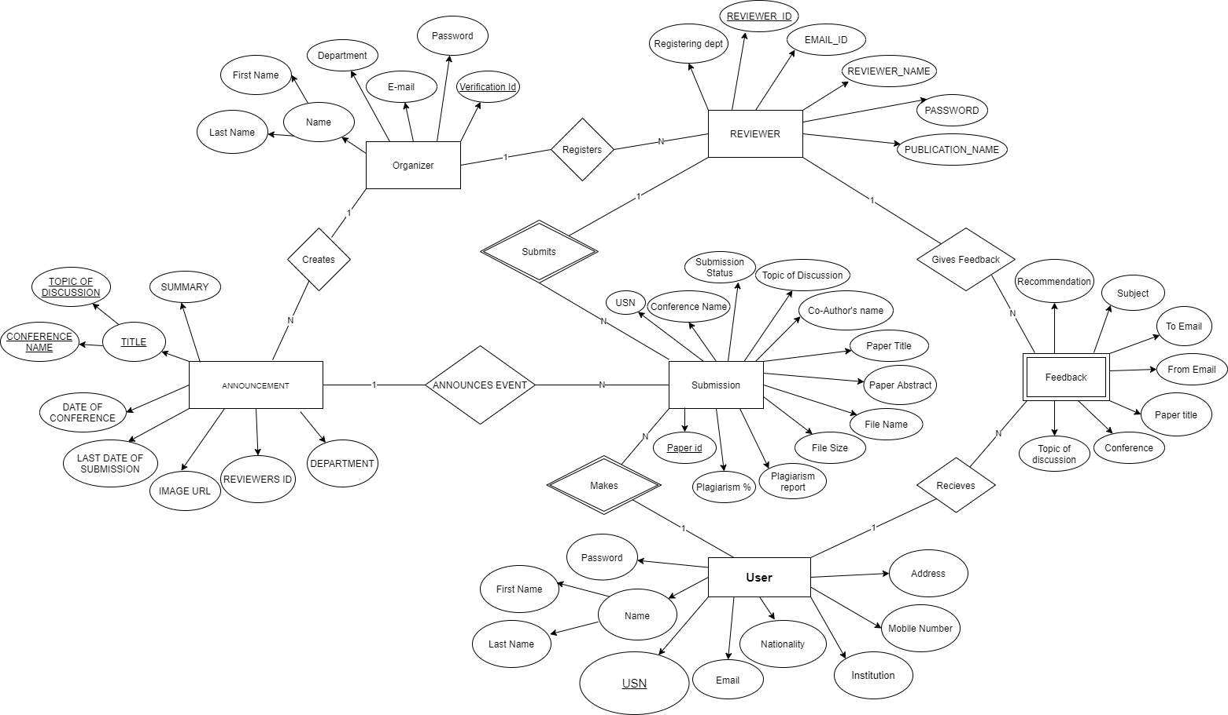
ER DIAGRAM OF THE PROJECT

Slide 5
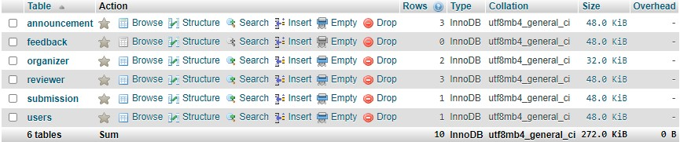
Design
Database:

Slide 6
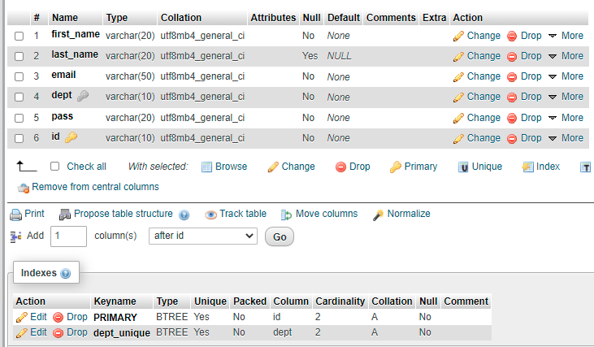
Table Design:
Organizer Table:

Slide 7
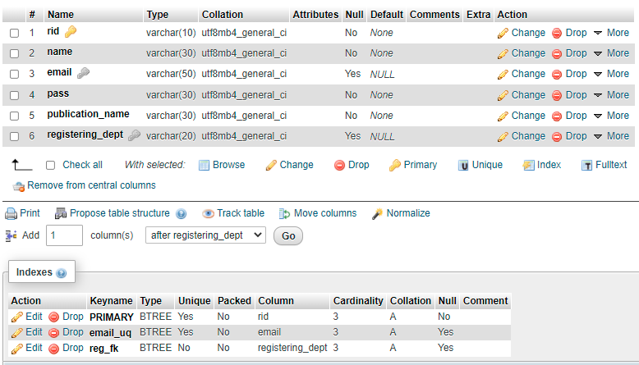
Reviewer Table:

Slide 8
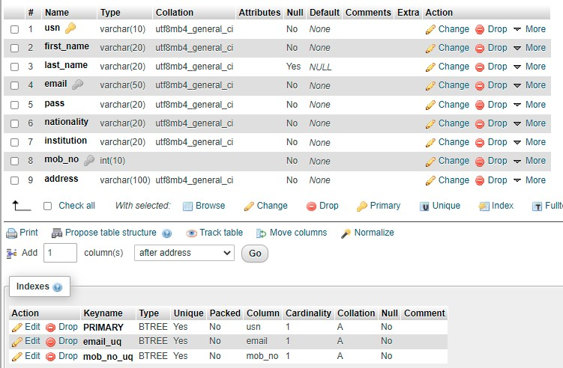
User Table:

Slide 9
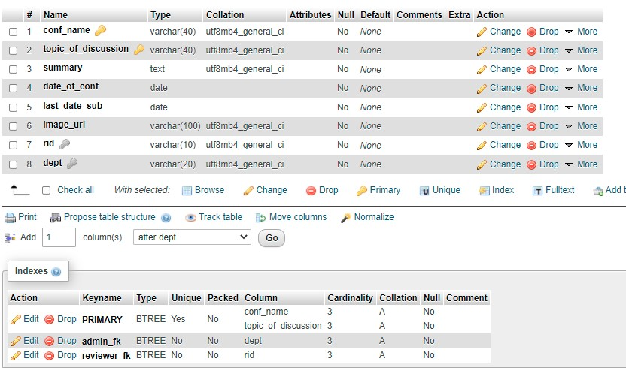
Announcement table:

Slide 10
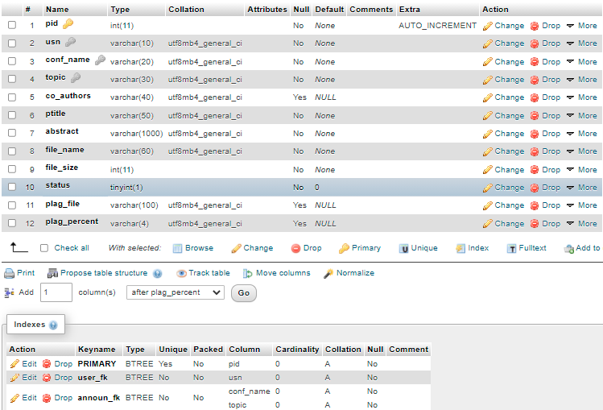
Submission table:

Slide 11
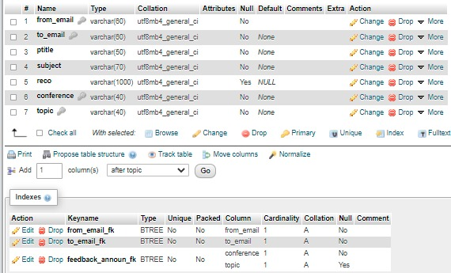
Feedback table:

Slide 12
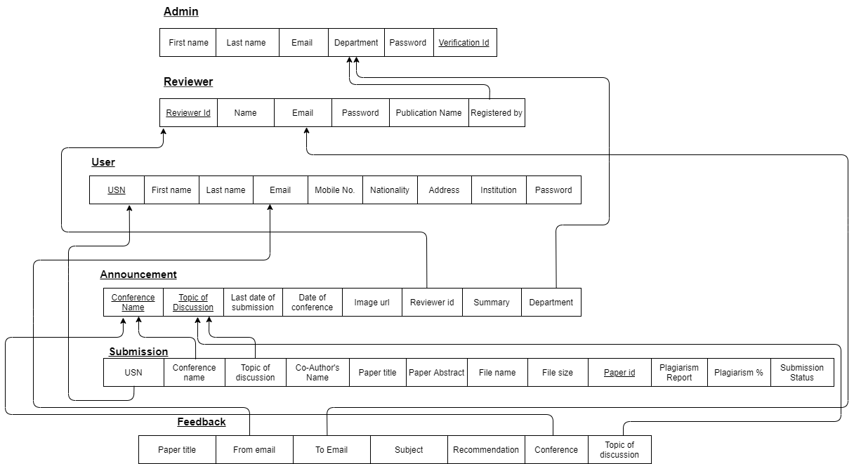
Relationship SCHEMA OF THE PROJECT

Slide 13
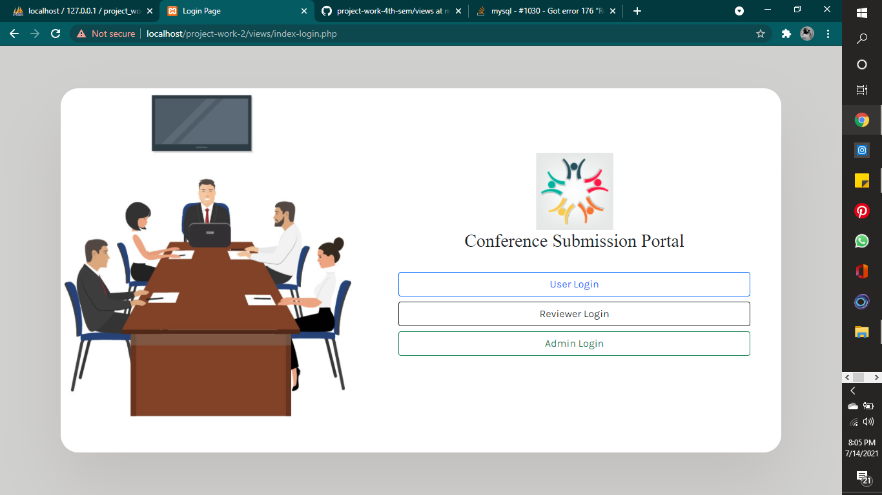
Login Portal:

Slide 14
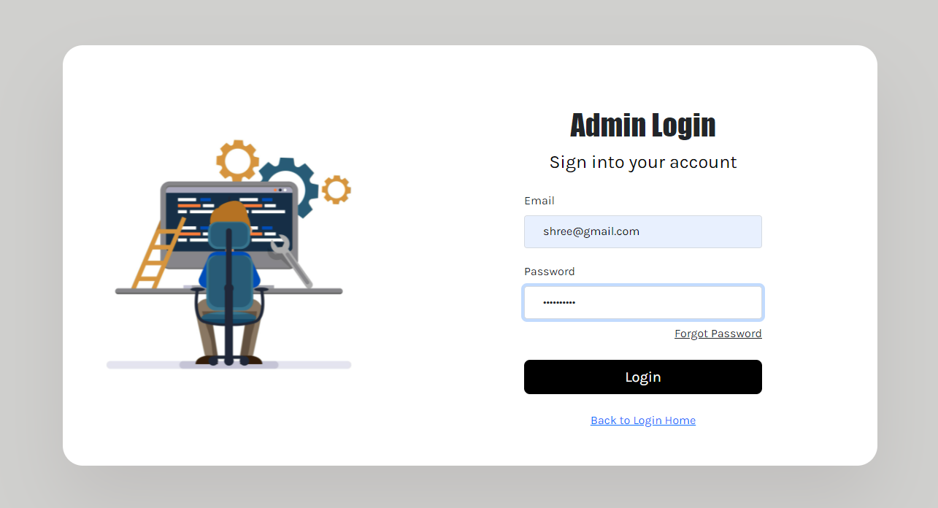
USER INTERFACE DESIGN
1. Admin:
1.1 Admin Login:

Slide 15
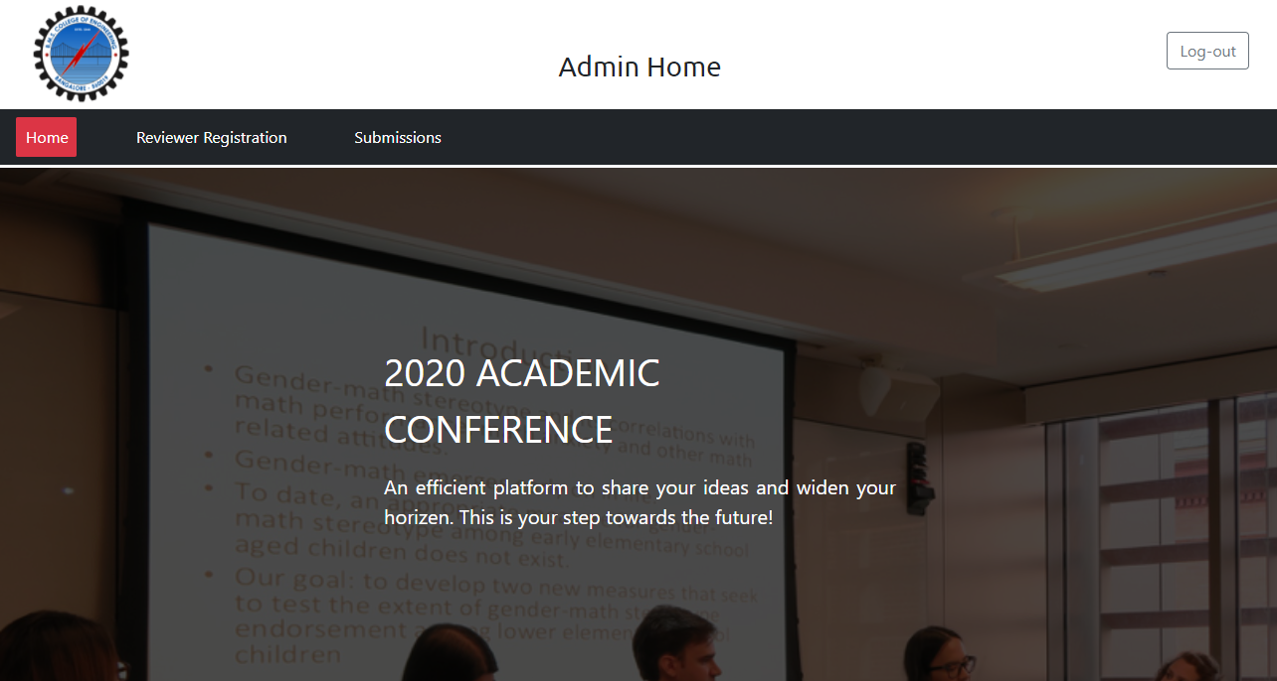
1.2Admin home page

Slide 16
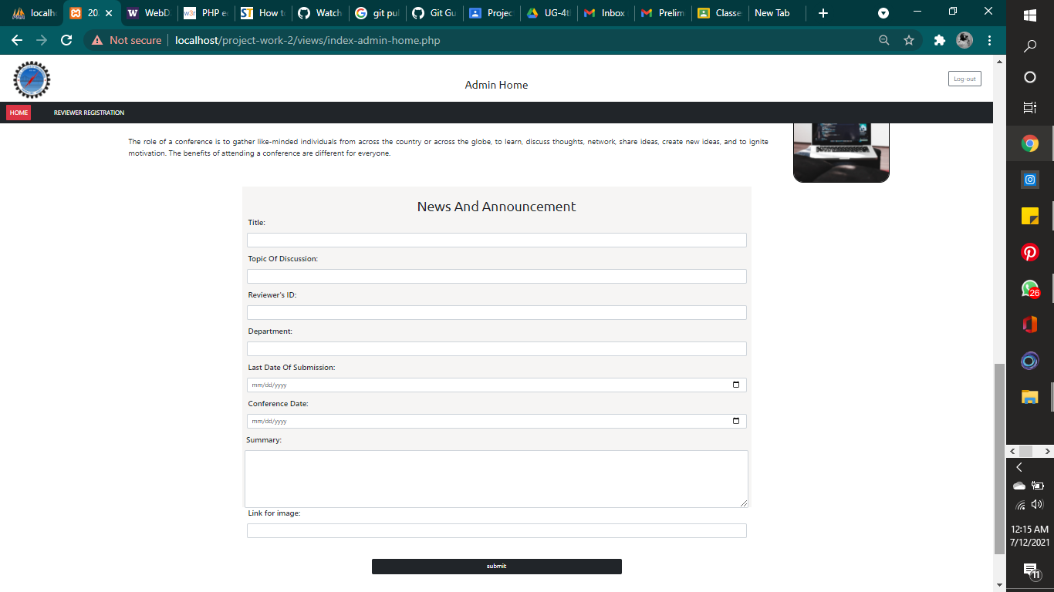
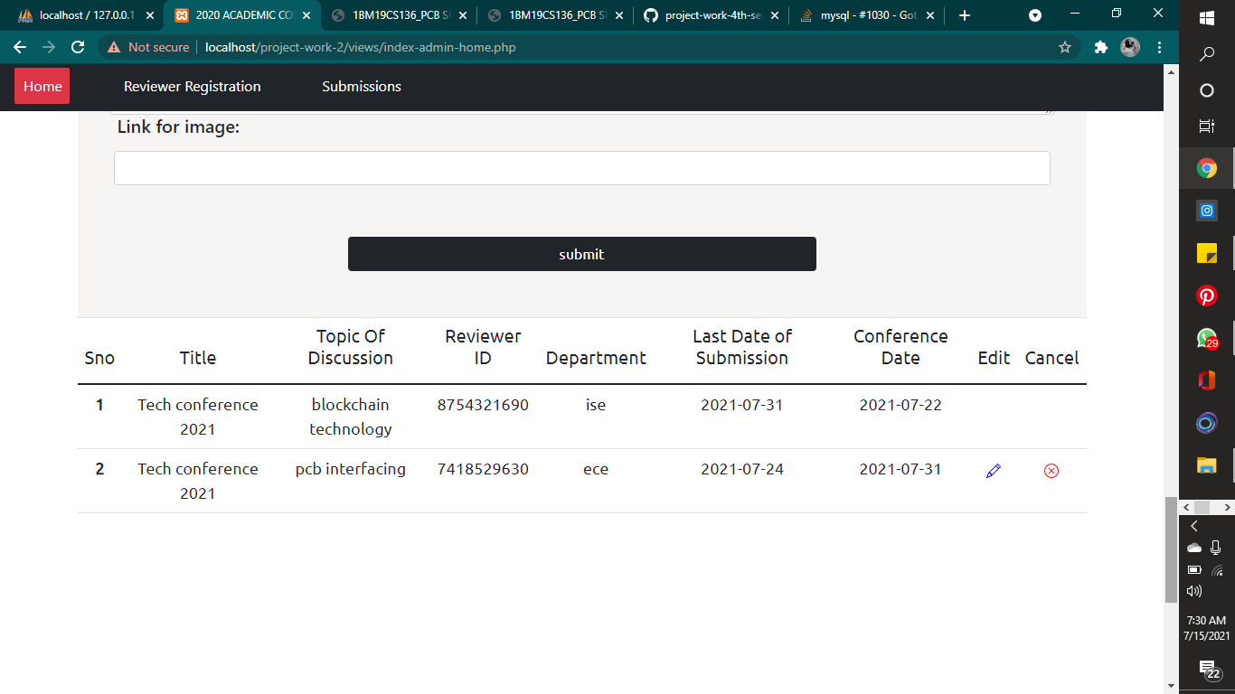
1.2.1News and announcement:
After Submitting:

Slide 17
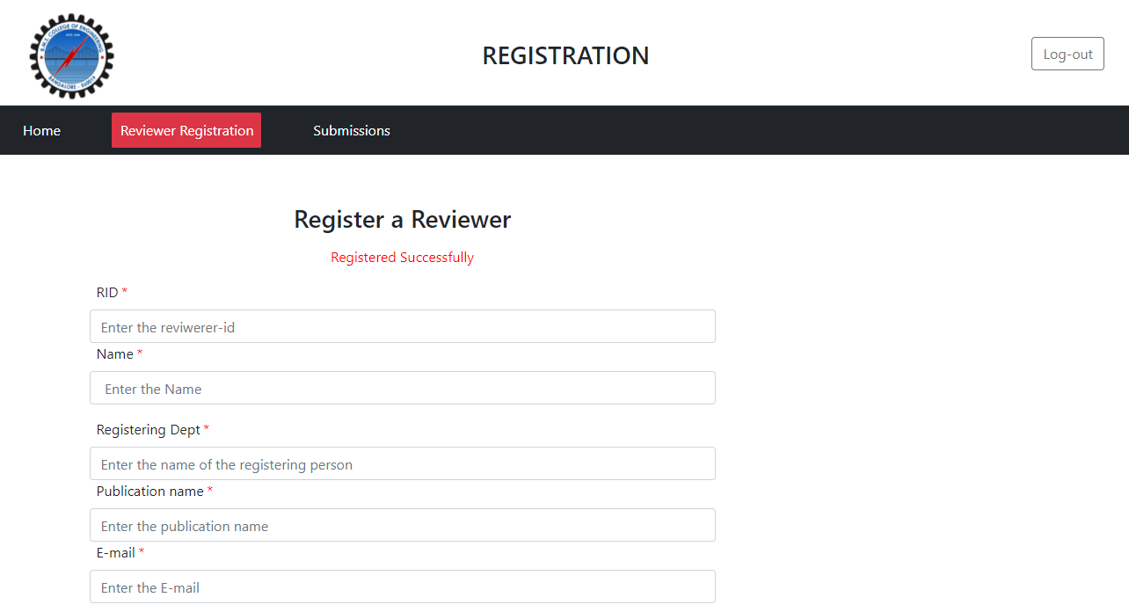
1.3 Admin_reviewer

Slide 18
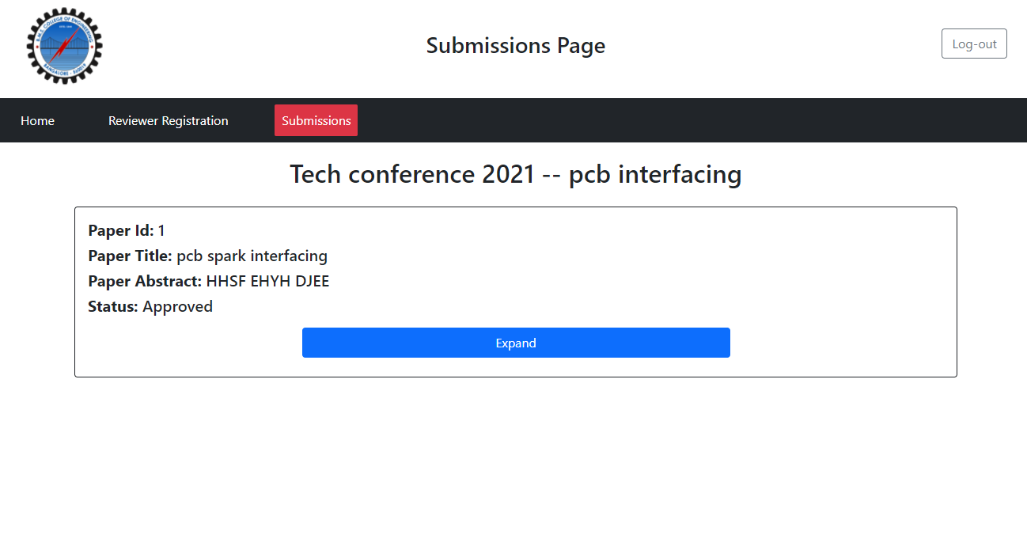
1.4 Submissions:

Slide 19
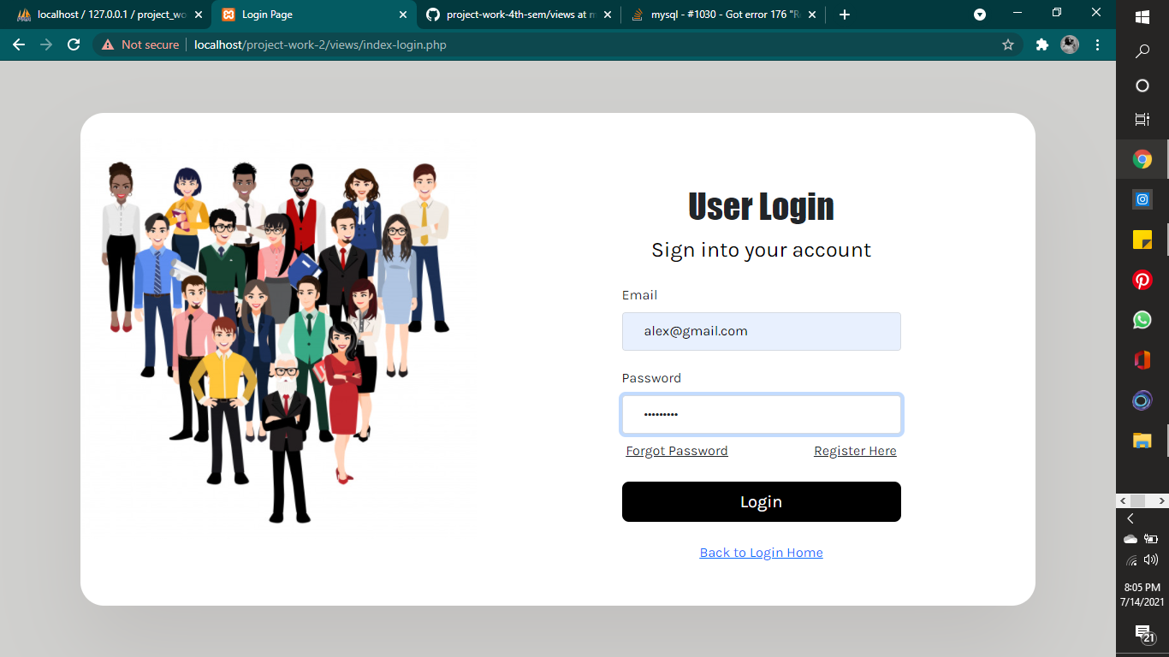
2. User:
2.1 User Login:

Slide 20
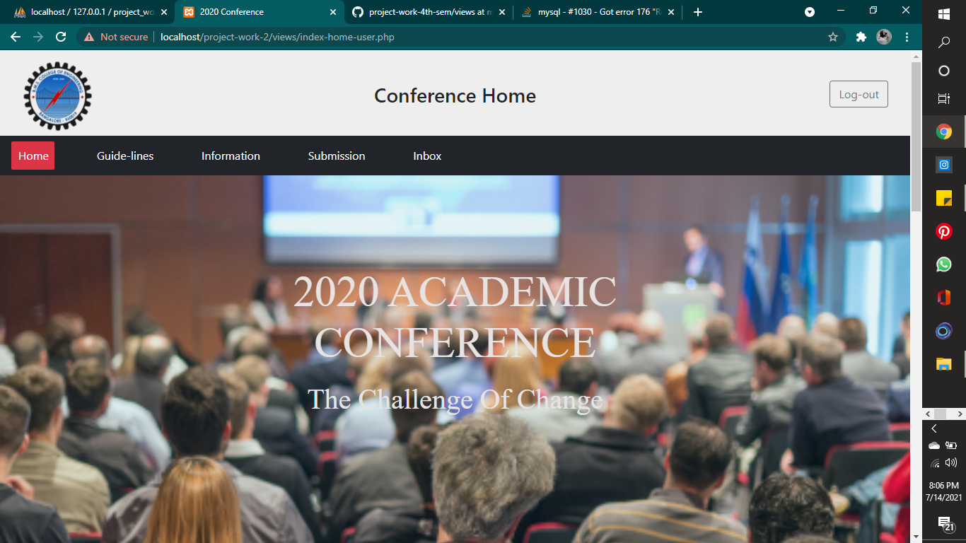
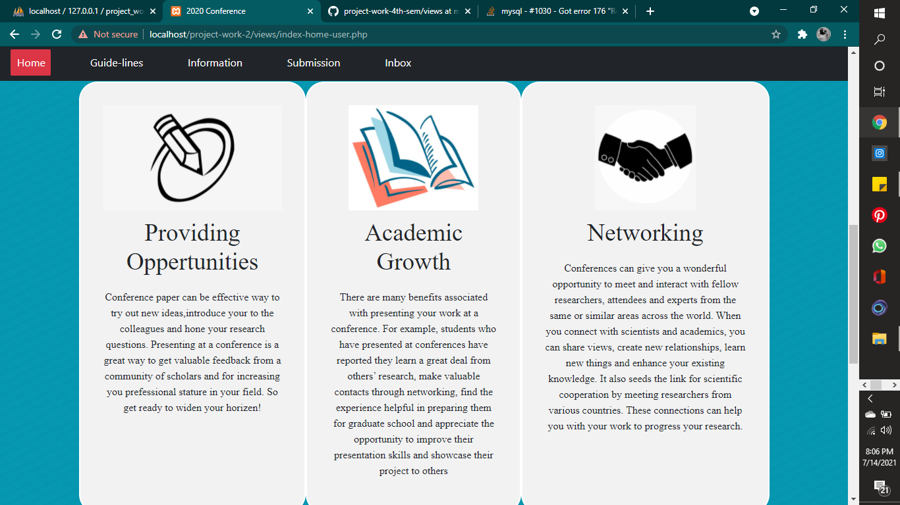
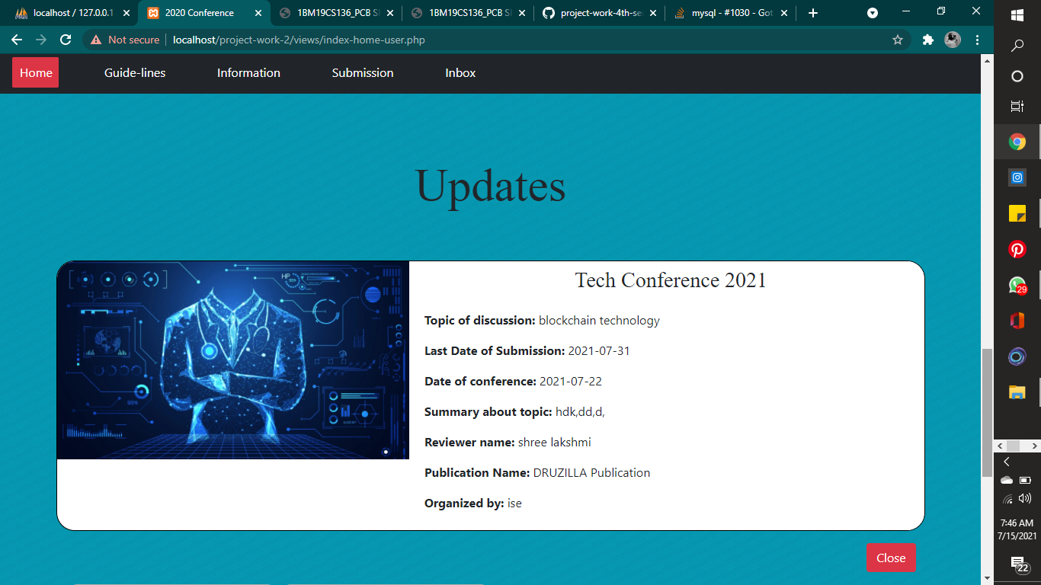
2.2 Home

Slide 21
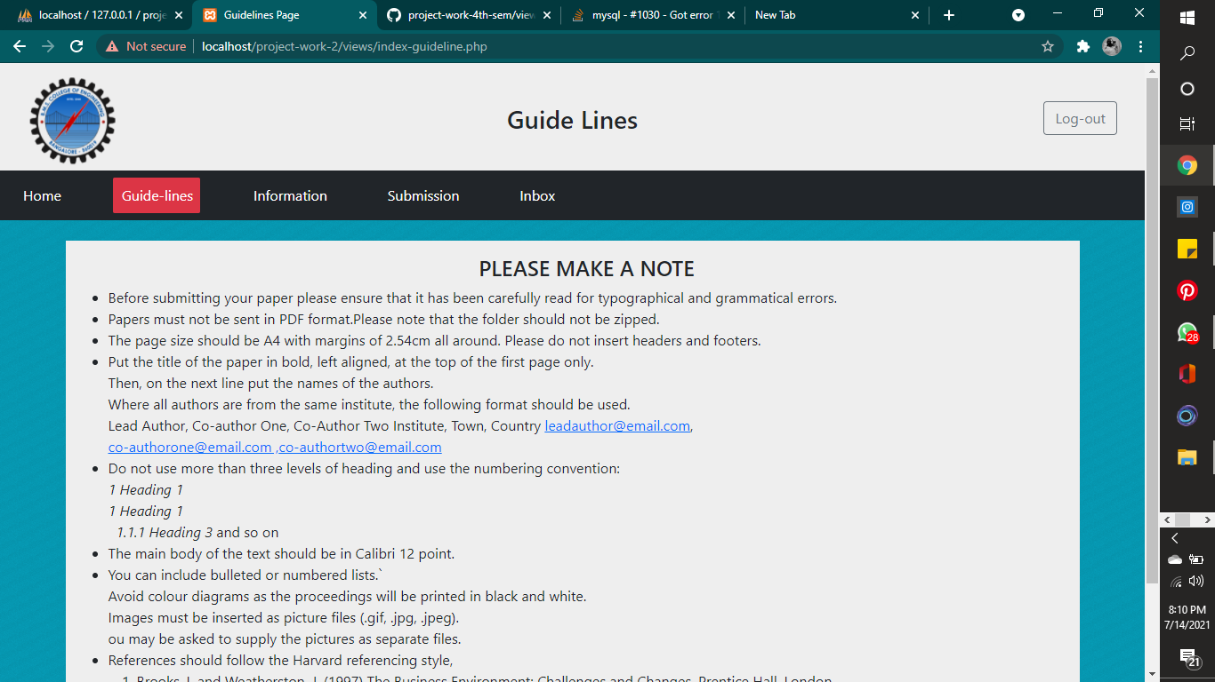
2.3 Guidelines

Slide 22
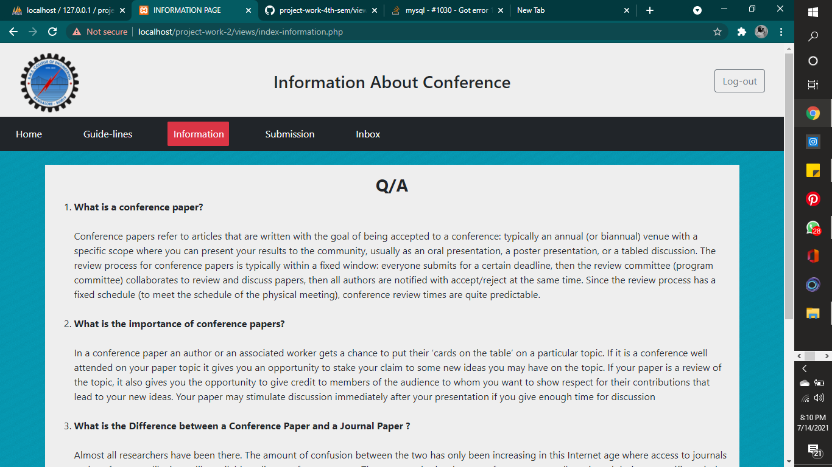
2.4 Information

Slide 23
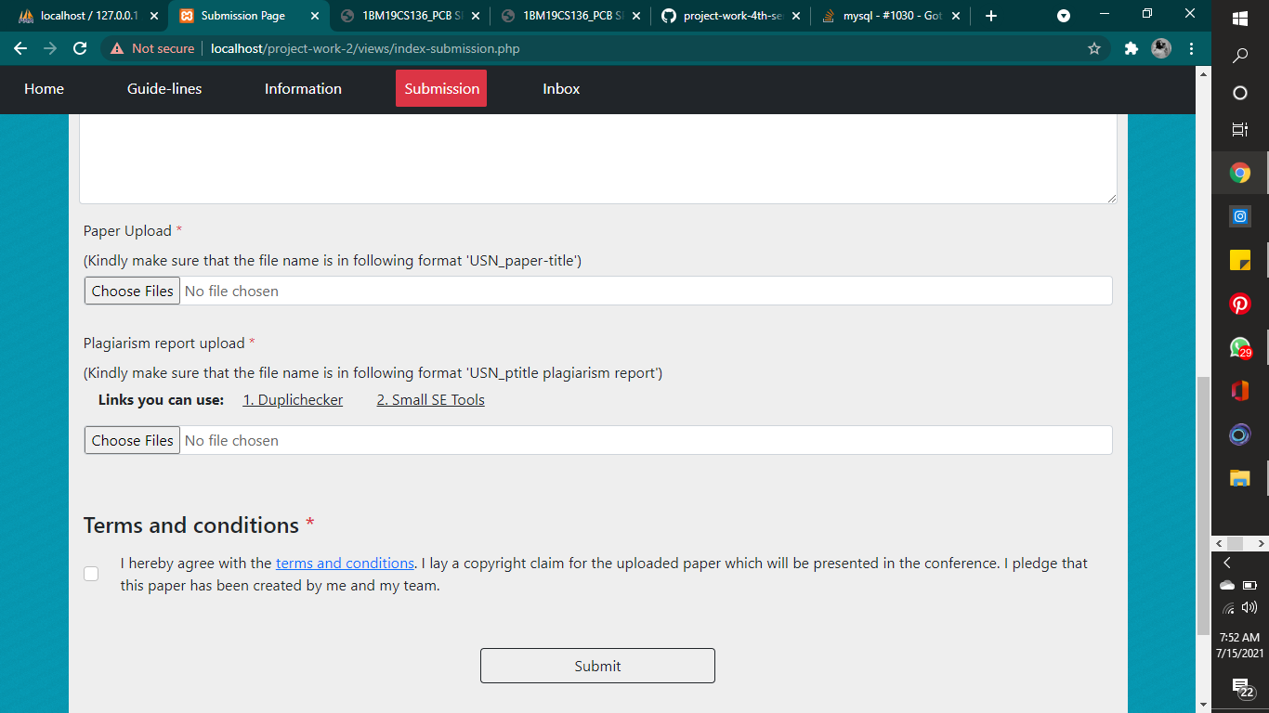
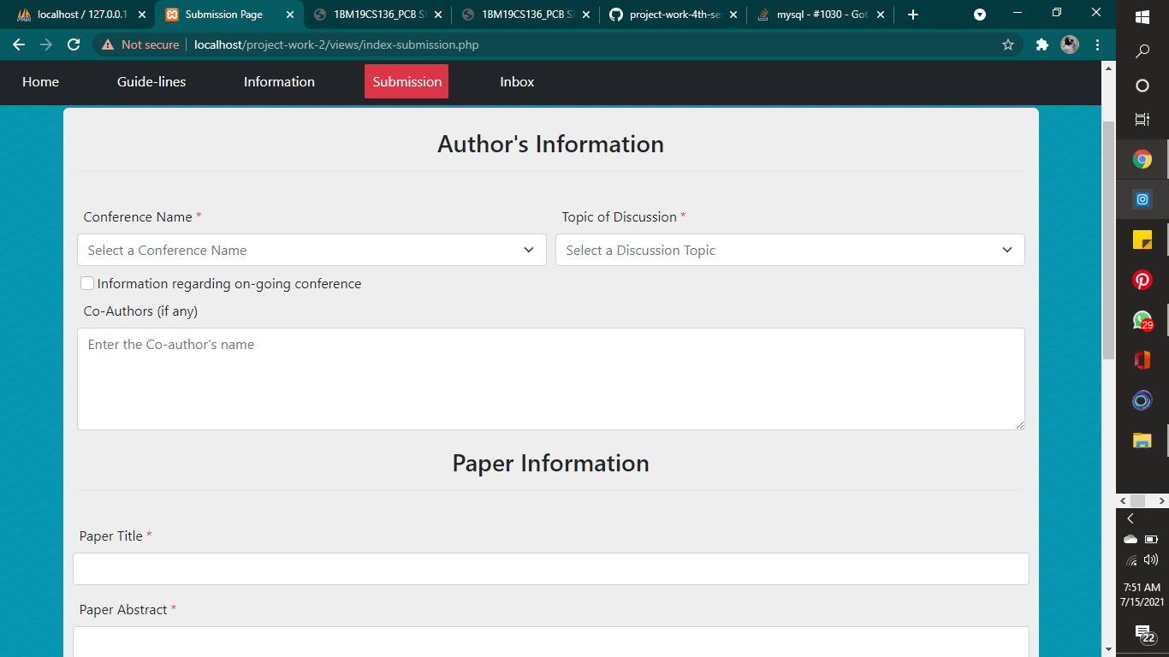
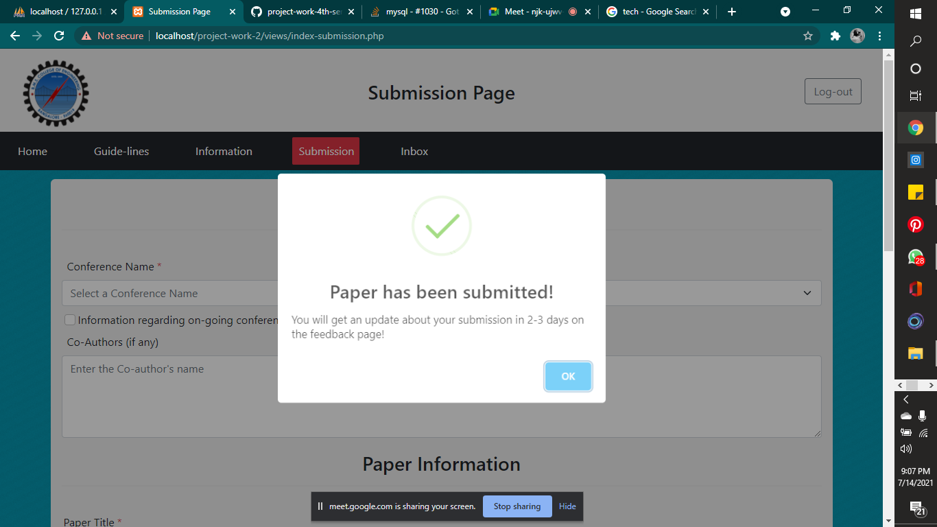
2.5 Submission

Slide 24
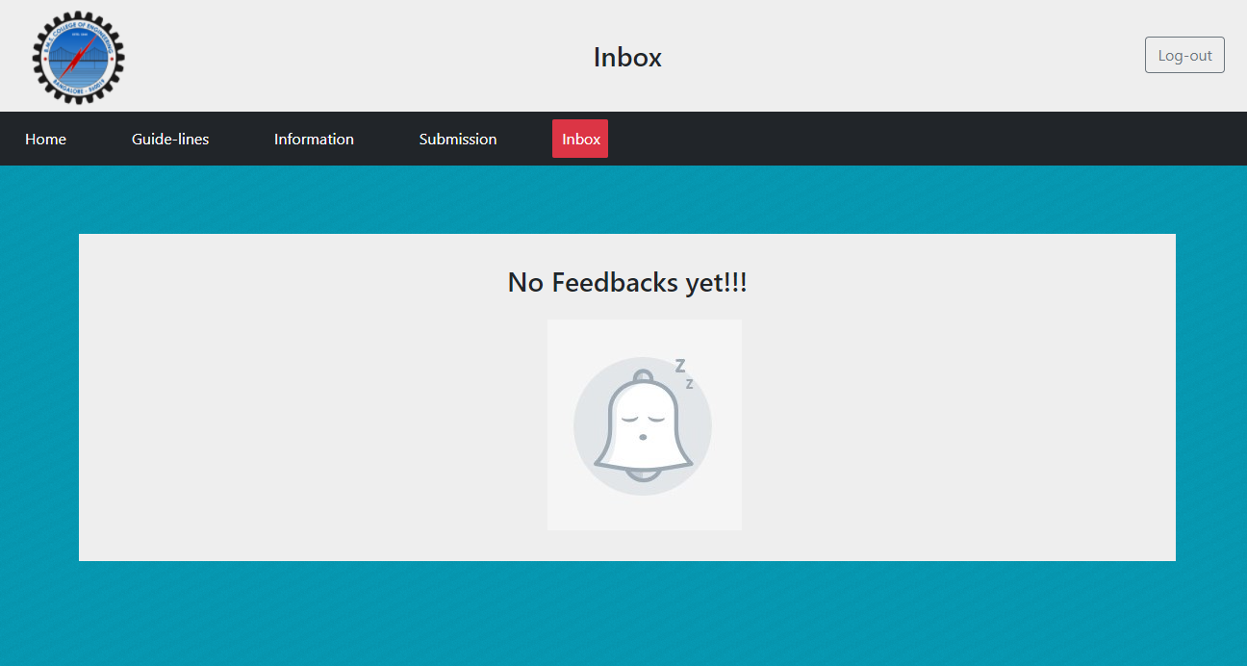
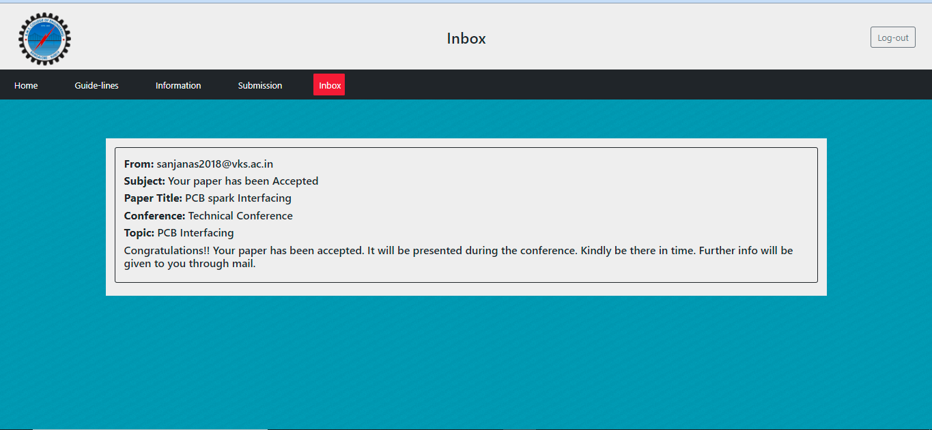
2.6 Inbox

Slide 25
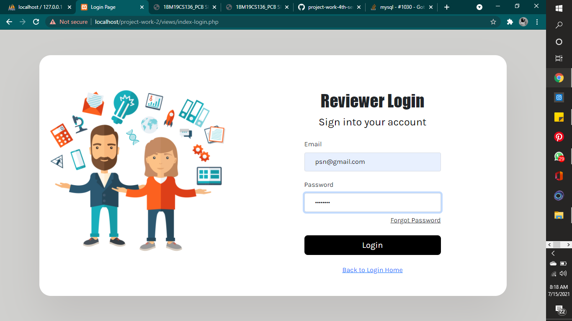
3. Reviewer:
3.1 Reviewer Login:

Slide 26
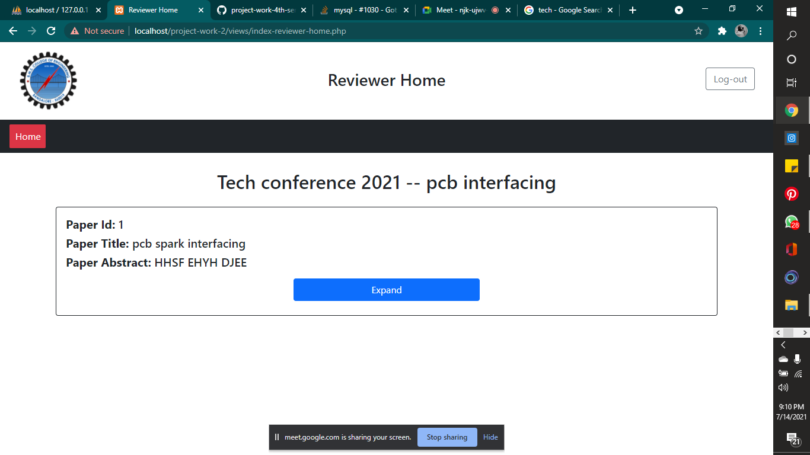
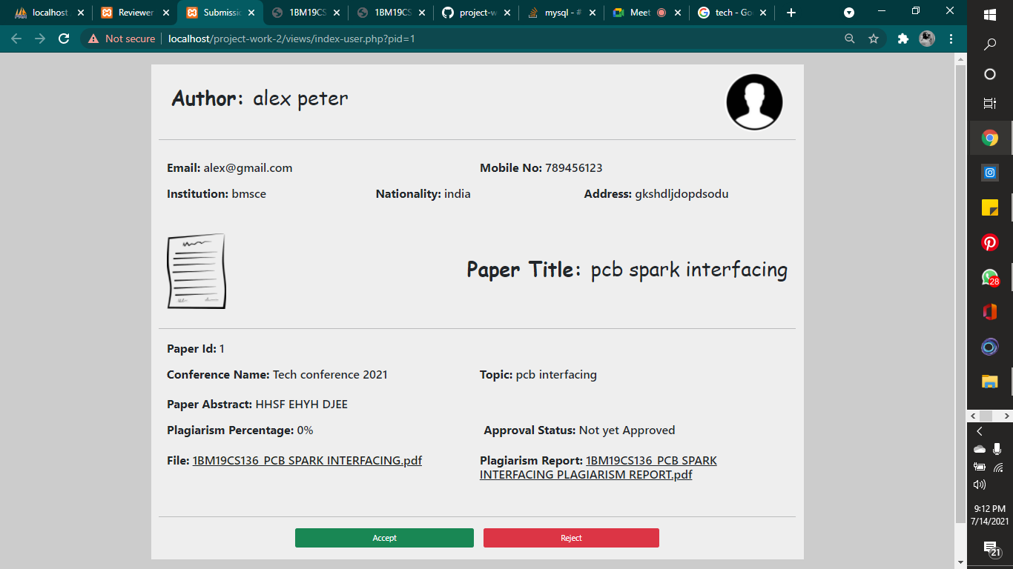
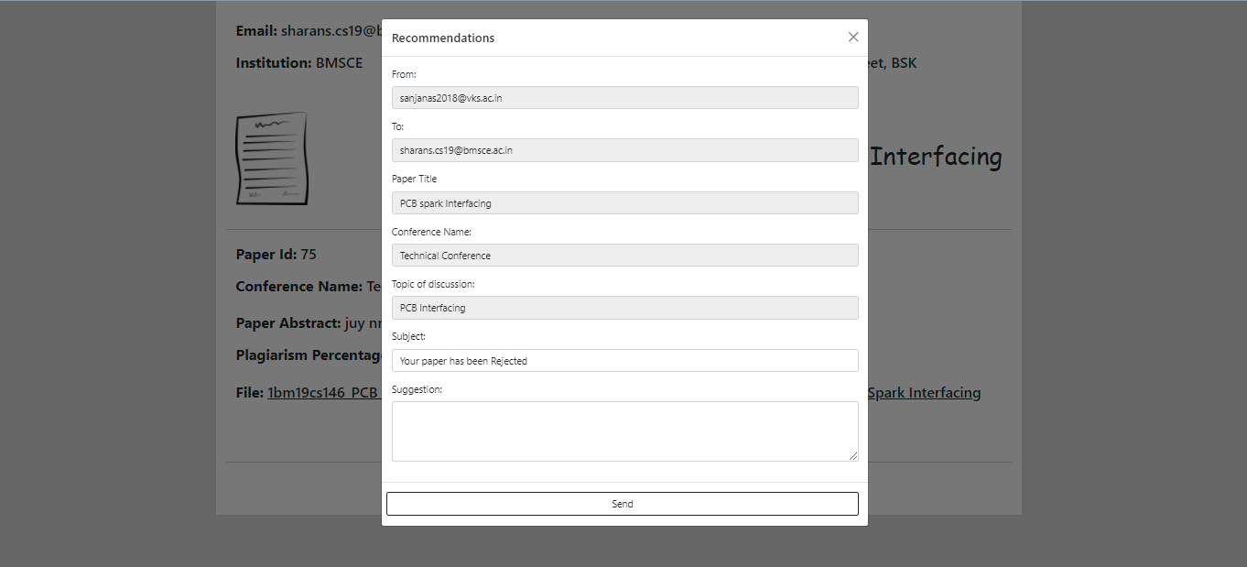
3.2 Reviewer Home

Slide 27
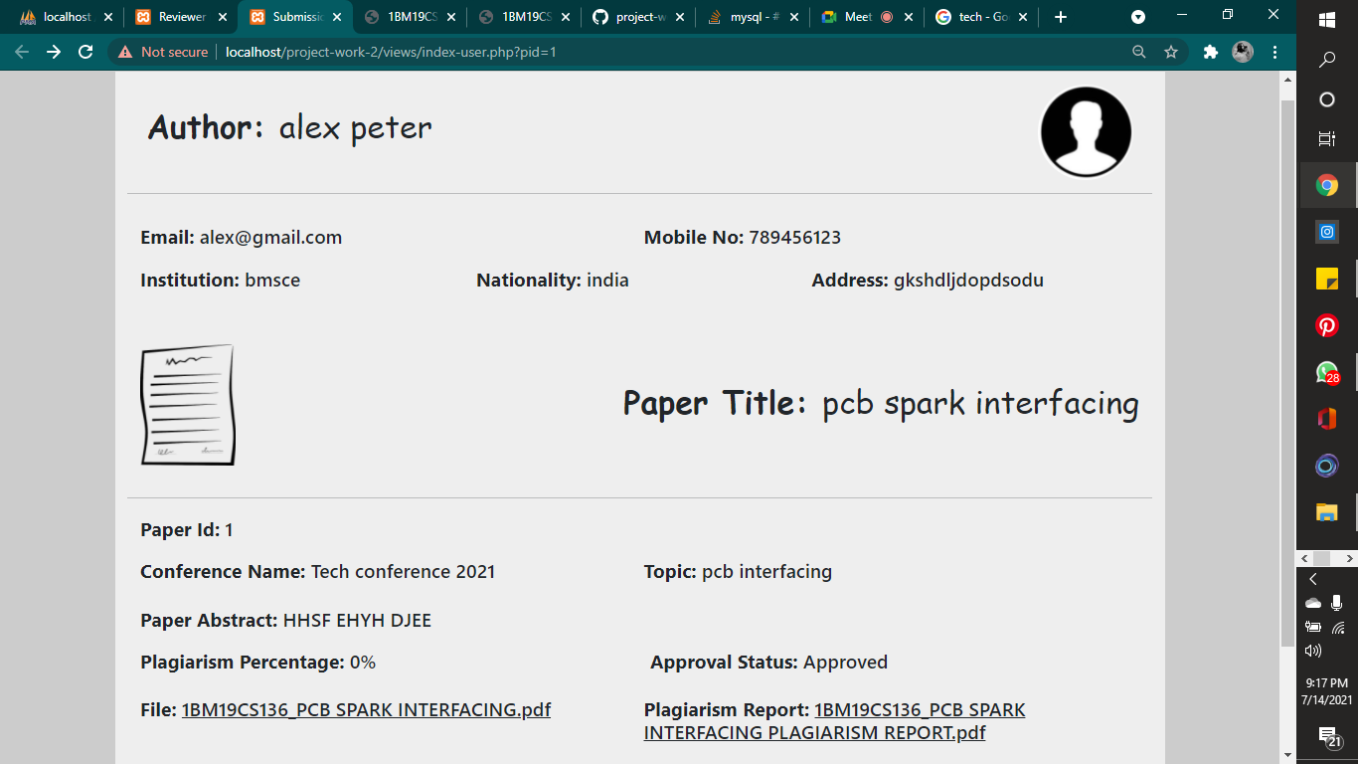
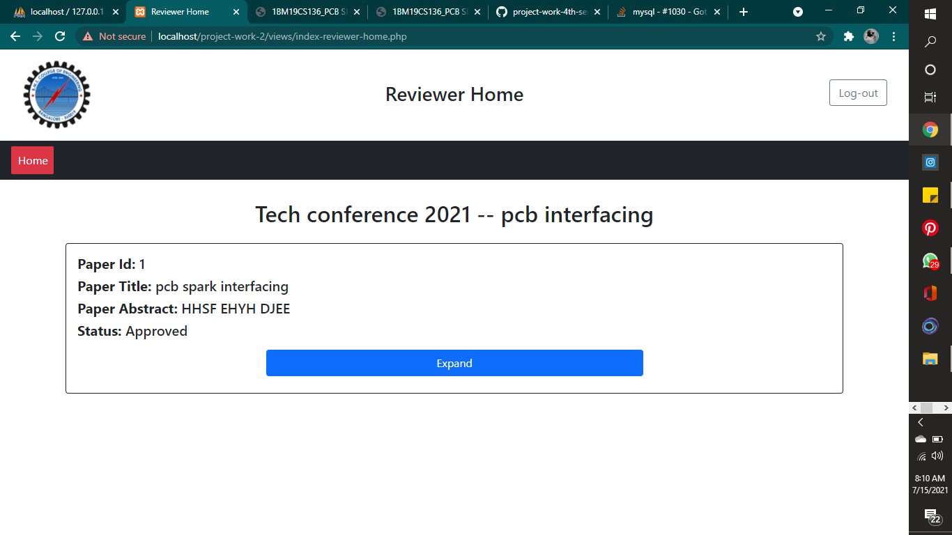

Slide 28
THANK YOU!
S SHREE LAKSHMI (1BM19CS136)
SAKSHI ROY (1BM19CS140)
SHARAN S PAI (1BM19CS146)
SHASHANK SHARMA (1BM19CS147)

